Slide 1
Optimizing Customer Purchasing Patterns
Rishabh Dev Chawla
rdc2697@gmail.com | (206) 496-6627

Slide 2
Project Overview
Objective: Improve the accuracy of customer income level and purchasing pattern estimation to enable more targeted marketing strategies.
Challenge: Existing models for estimating customer income levels and purchasing patterns were inaccurate, leading to suboptimal marketing strategies.
Expected Outcomes:
Enhanced accuracy in estimating customer income and purchasing patterns.
Improved ability to target marketing efforts effectively.
Increased customer engagement and conversion rates through personalized marketing strategies.

Slide 3
Project Overview
Data Collection: Aggregated data from CRM and sales databases.
Data Cleaning: Removed duplicates and handled missing values to ensure data integrity.
Feature Engineering: Created new features such as average purchase frequency and total spend.
Clustering: Used K Means Clustering to segment customers based on income and purchasing patterns.
Predictive Modeling: Developed and validated models to forecast future customer behaviors.

Slide 4
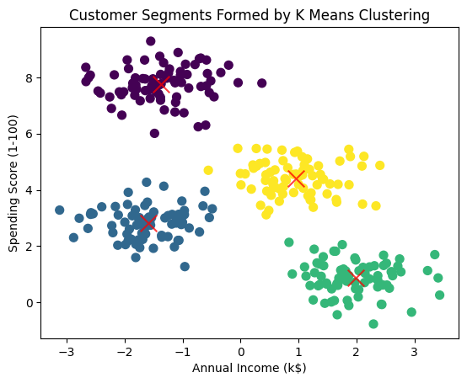
Clustering Methodology
Algorithm: K Means Clustering
Steps:
Standardized the data
Applied the Elbow Method to determine optimal clusters
Executed K Means Clustering

Slide 5
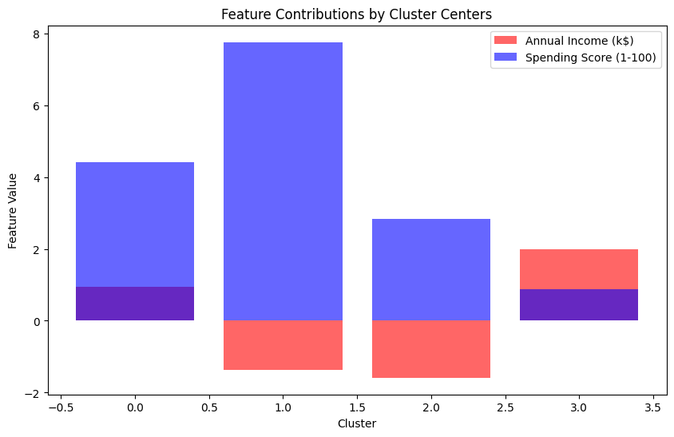
Cluster Centers Analysis
Analysis:
Examined cluster centers to understand feature contributions
Visualized the importance of features like annual income and spending score in forming clusters

Slide 6
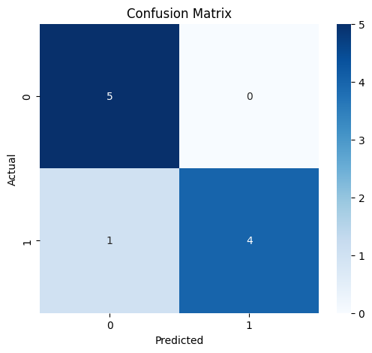
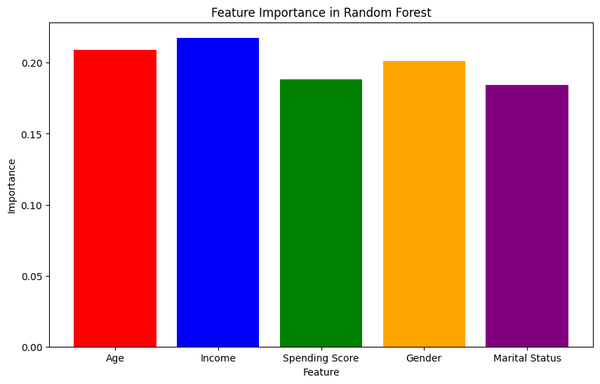
Predictive Modeling
Model: Logistic Regression
Purpose: Predict customer responses to marketing campaigns
Accuracy: Demonstrated through confusion matrix
Model: Random Forest
Purpose: Identify key features influencing predictions

Slide 7
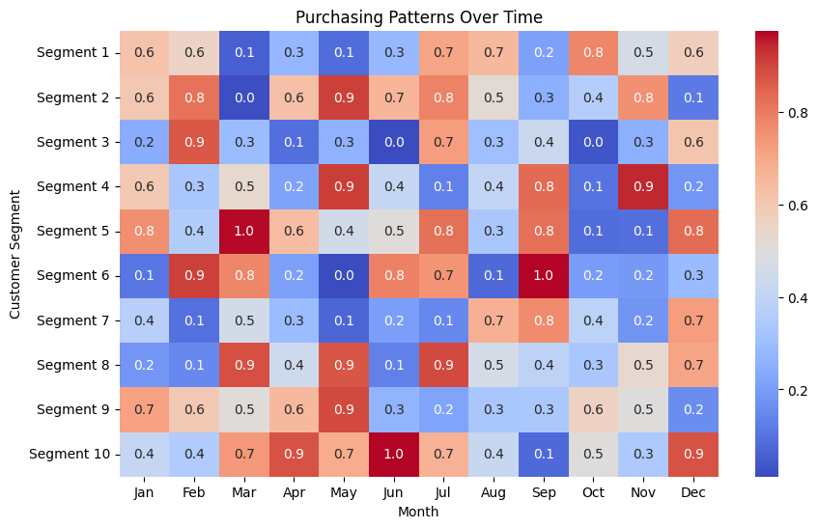
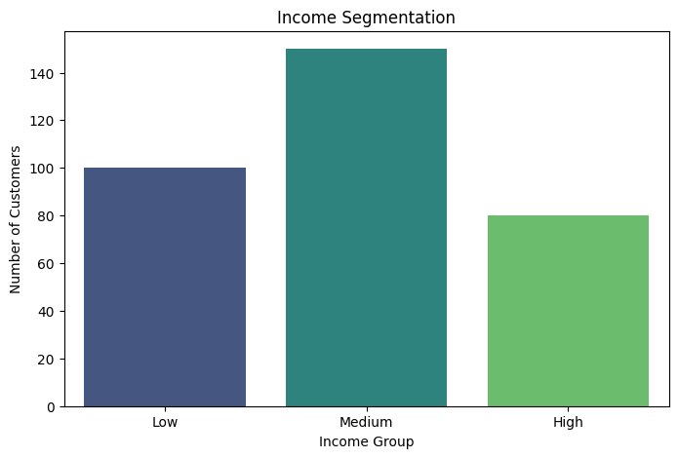
Visualizations
Visualization: Displayed distinct customer segments based on income
Visualization: Displayed distinct customer segments based on income

Slide 8
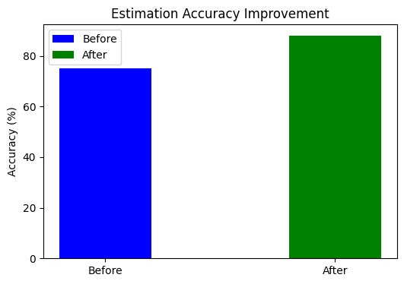
Business Impact
Before and After Comparison: Showed improvement from 75% to 88% accuracy
Impact: Enabled precise and effective marketing campaigns and personalized strategies

Slide 9
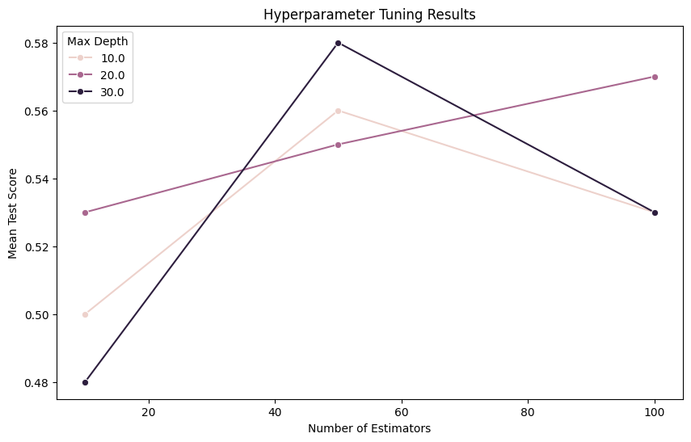
Technical Details and Challenges
Challenges:
Ensuring data accuracy and completeness
Improving model performance through feature engineering and parameter tuning
Solutions:
Implemented robust data preprocessing techniques
Utilized advanced model tuning methods

